Slide 1
Classification and Regression Trees Clustering Support Vector Machines

Slide 2
Trees and Rules
Goal: Classify or predict an outcome based on a set of predictors
The output is a set of rules
Example:
Goal: classify a record as “will accept credit card offer” or “will not accept”
Rule might be “IF (Income > 92.5) AND (Education < 1.5) AND (Family <= 2.5) THEN Class = 0 (nonacceptor)
Also called CART, Decision Trees, or just Trees
Rules are represented by tree diagrams

Slide 3
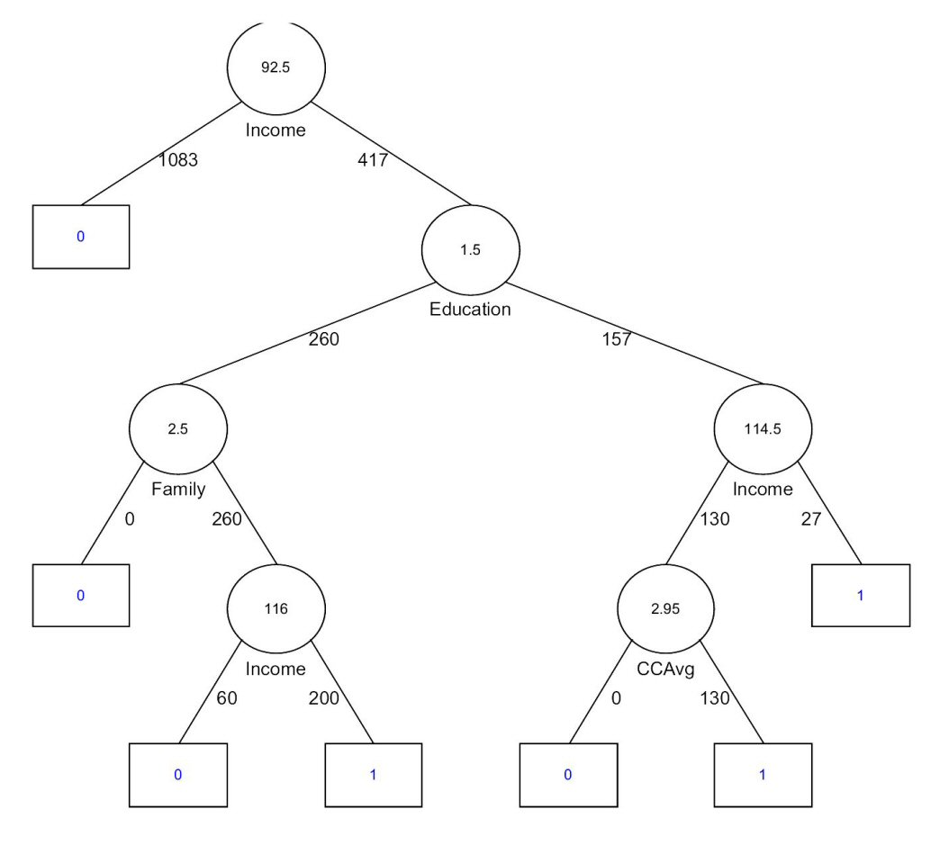

Slide 4
Key Ideas
Recursive partitioning: Repeatedly split the records into two parts so as to achieve maximum homogeneity within the new parts
Pruning the tree: Simplify the tree by pruning peripheral branches to avoid overfitting

Slide 5
Recursive Partitioning

Slide 6
Recursive Partitioning Steps
Pick one of the predictor variables, x_{i}
Pick a value of x_{i,} say s_{i}, that divides the training data into two (not necessarily equal) portions
Measure how “pure” or homogeneous each of the resulting portions are
“Pure” = containing records of mostly one class
Algorithm tries different values of x_{i,} and s_{i} to maximize purity in initial split
After you get a “maximum purity” split, repeat the process for a second split, and so on

Slide 7
Example: Riding Mowers
Goal: Classify 24 households as owning or not owning riding mowers
Predictors = Income, Lot Size

Slide 9
How to split
Order records according to one variable, say lot size
Find midpoints between successive values
E.g. first midpoint is 14.4 (halfway between 14.0 and 14.8)
Divide records into those with lotsize > 14.4 and those < 14.4
After evaluating that split, try the next one, which is 15.4 (halfway between 14.8 and 16.0)

Slide 10
Note: Categorical Variables
Examine all possible ways in which the categories can be split.
E.g., categories A, B, C can be split 3 ways
{A} and {B, C}
{B} and {A, C}
{C} and {A, B}
With many categories, # of splits becomes huge

Slide 11
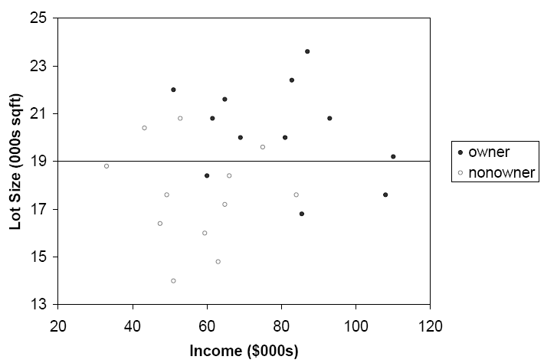
The first split: Lot Size = 19,000

Slide 12
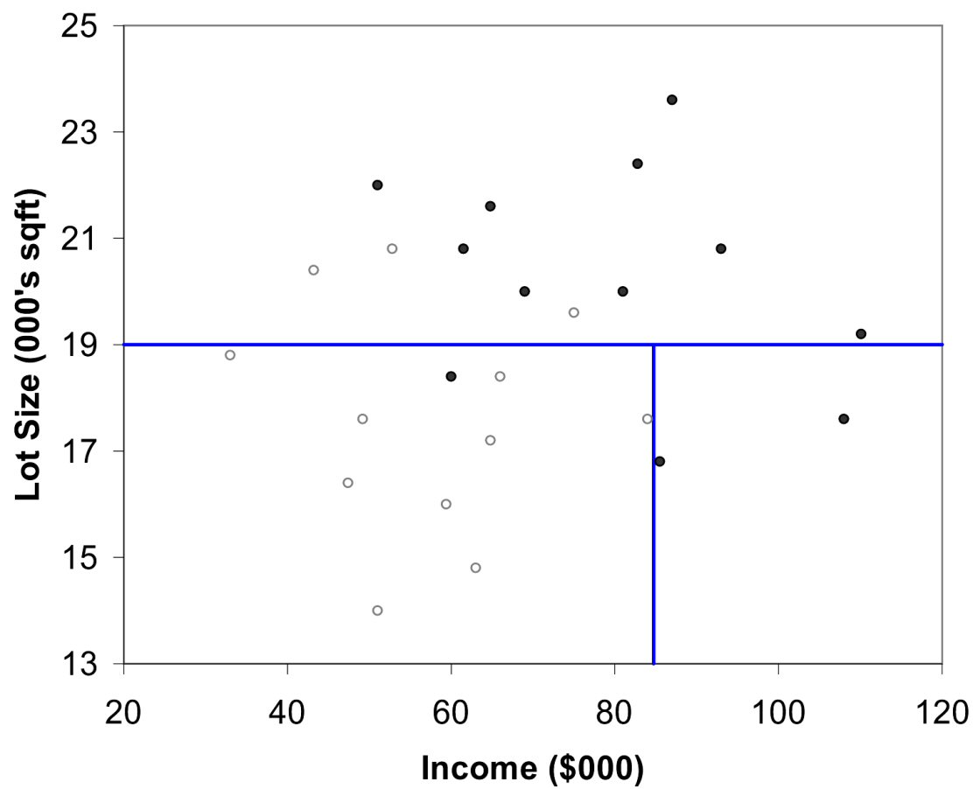
Second Split: Income = $84,000

Slide 13
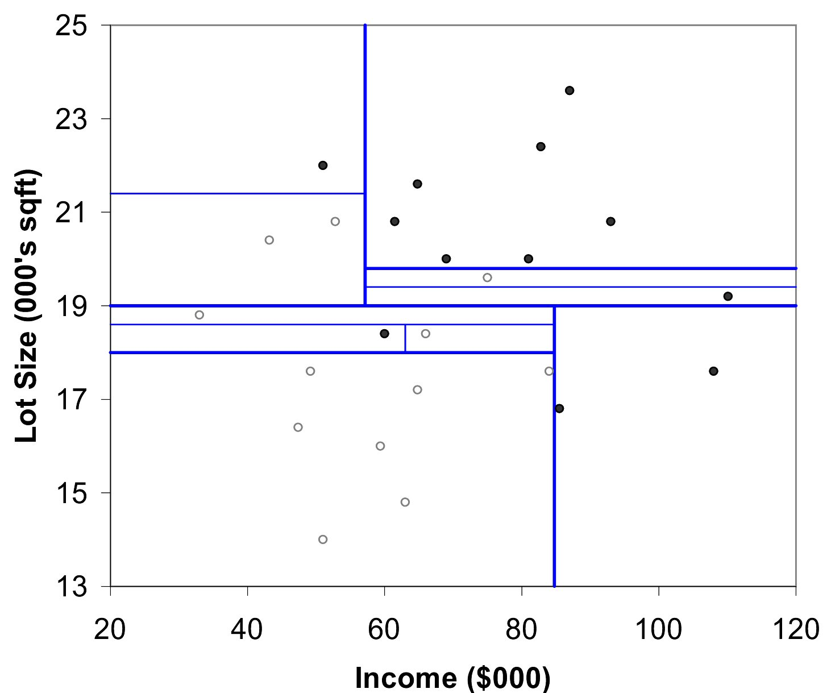
After All Splits

Slide 14
Measuring Impurity

Slide 15
Gini Index
Gini Index for rectangle A containing m records
p = proportion of cases in rectangle A that belong to class k
I(A) = 0 when all cases belong to same class
Max value when all classes are equally represented (= 0.50 in binary case)

Slide 16
Entropy
p = proportion of cases (out of m) in rectangle A that belong to class k
Entropy ranges between 0 (most pure) and log₂(m) (equal representation of classes)

Slide 17
Impurity and Recursive Partitioning
Obtain overall impurity measure (weighted avg. of individual rectangles)
At each successive stage, compare this measure across all possible splits in all variables
Choose the split that reduces impurity the most
Chosen split points become nodes on the tree

Slide 18
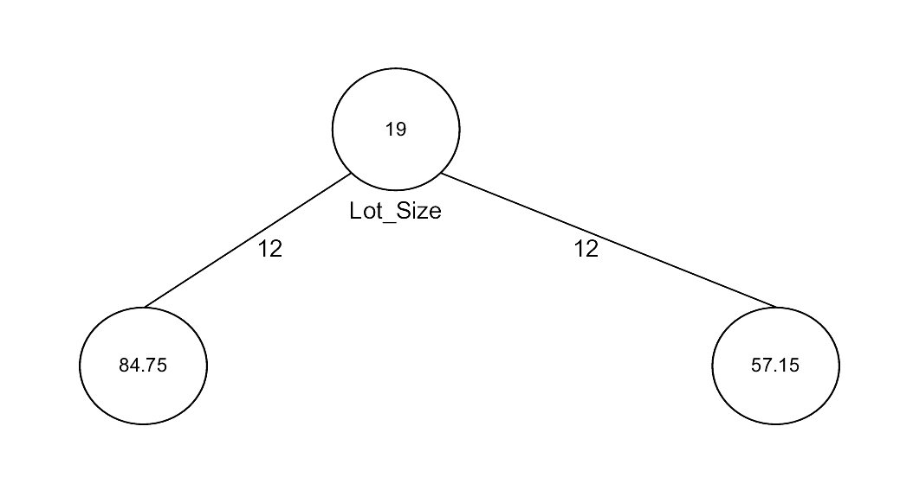
First Split – The Tree

Slide 19
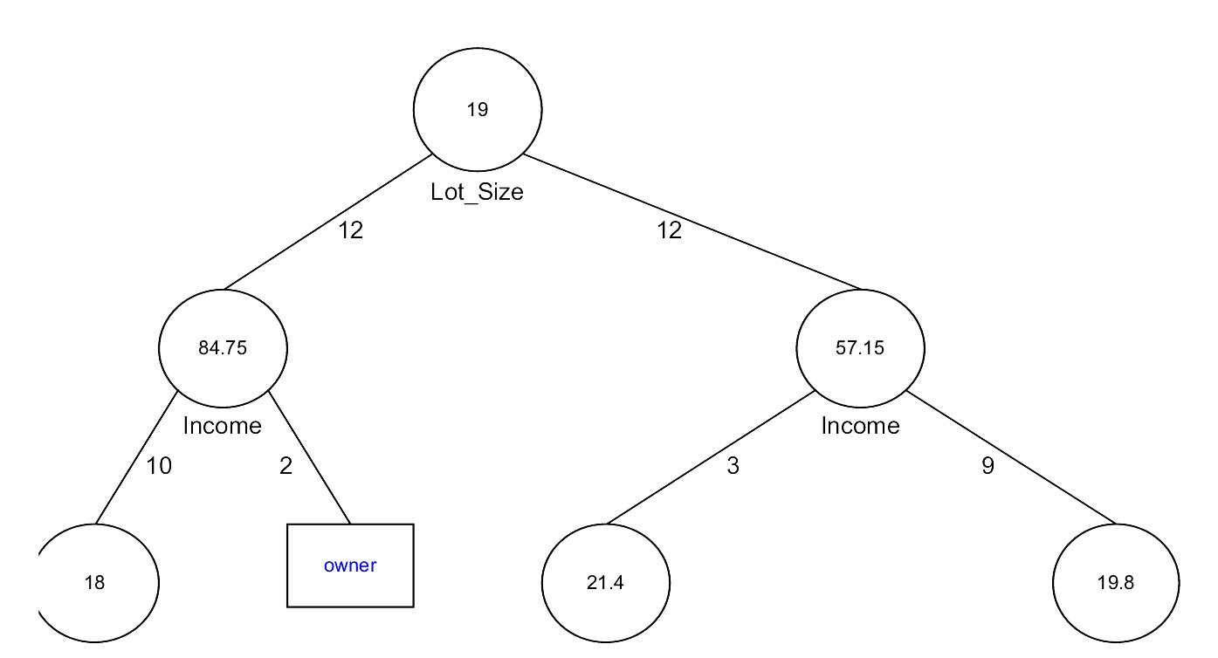
Tree after three splits

Slide 20
Tree Structure
Split points become nodes on tree (circles with split value in center)
Rectangles represent “leaves” (terminal points, no further splits, classification value noted)
Numbers on lines between nodes indicate # cases
Read down tree to derive rule
E.g., If lot size < 19, and if income > 84.75, then class = “owner”

Slide 21
Determining Leaf Node Label
Each leaf node label is determined by “voting” of the records within it, and by the cutoff value
Records within each leaf node are from the training data
Default cutoff=0.5 means that the leaf node’s label is the majority class.
Cutoff = 0.75: requires majority of 75% or more “1” records in the leaf to label it a “1” node

Slide 22
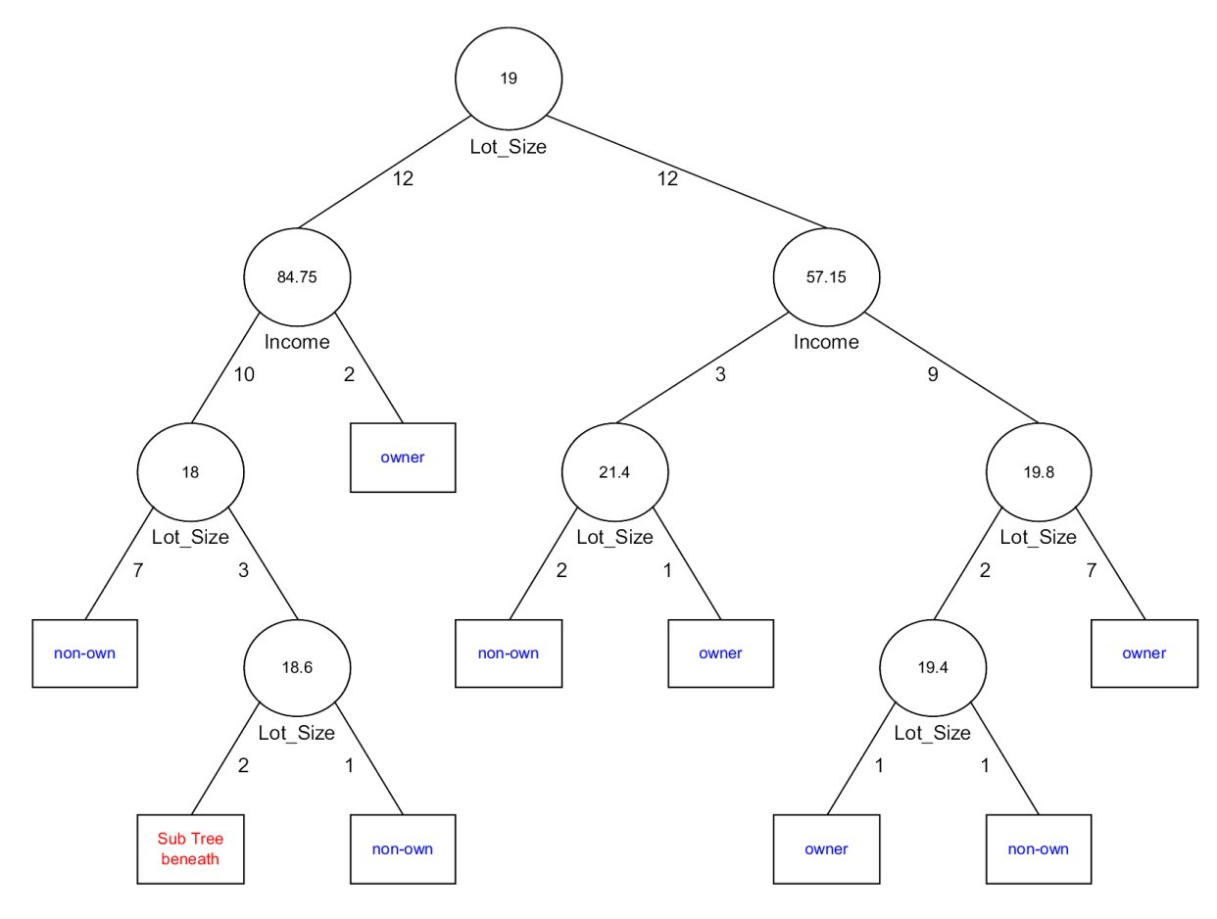
Tree after all splits

Slide 23
The Overfitting Problem

Slide 24
Stopping Tree Growth
Natural end of process is 100% purity in each leaf
This overfits the data, which end up fitting noise in the data
Overfitting leads to low predictive accuracy of new data
Past a certain point, the error rate for the validation data starts to increase

Slide 25
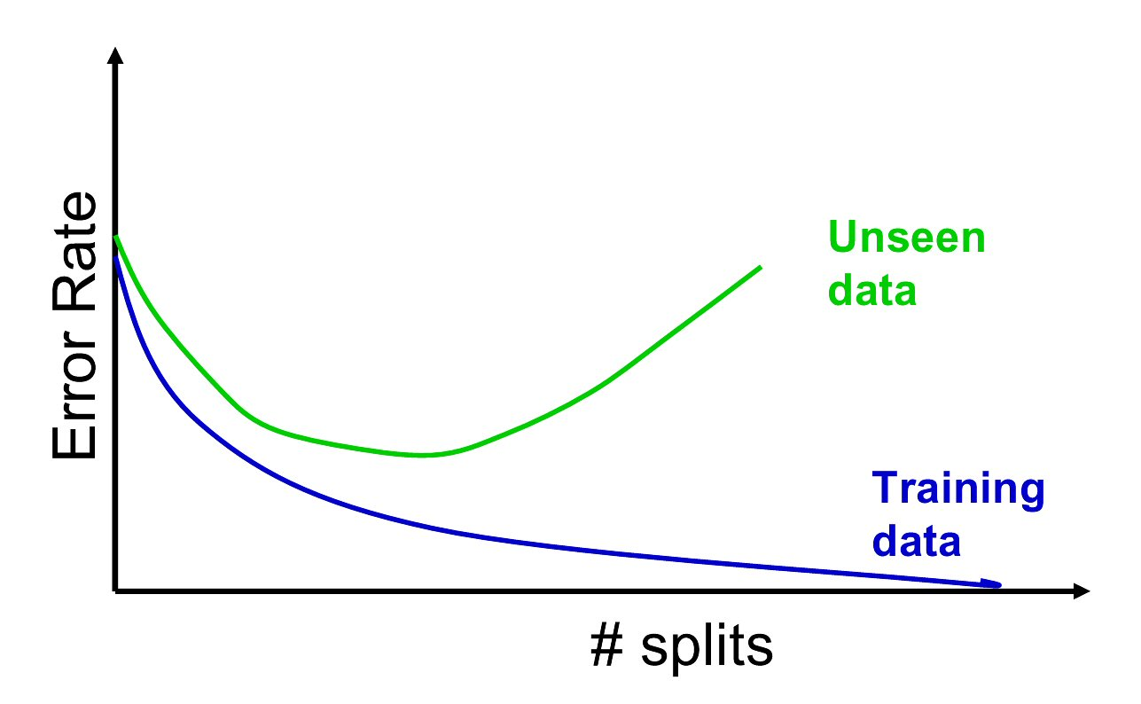
Full Tree Error Rate

Slide 26
CHAID
CHAID, older than CART, uses chi-square statistical test to limit tree growth
Splitting stops when purity improvement is not statistically significant

Slide 27
Pruning
CART lets tree grow to full extent, then prunes it back
Idea is to find that point at which the validation error begins to rise
Generate successively smaller trees by pruning leaves
At each pruning stage, multiple trees are possible
Use cost complexity to choose the best tree at that stage

Slide 28
Cost Complexity
CC(T) = Err(T) + α L(T)
CC(T) = cost complexity of a tree
Err(T) = proportion of misclassified records
α = penalty factor attached to tree size (set by user)
Among trees of given size, choose the one with lowest CC
Do this for each size of tree

Slide 29
Using Validation Error to Prune
Pruning process yields a set of trees of different sizes and associated error rates
Two trees of interest:
Minimum error tree
Has lowest error rate on validation data
Best pruned tree
Smallest tree within one std. error of min. error
This adds a bonus for simplicity/parsimony

Slide 30
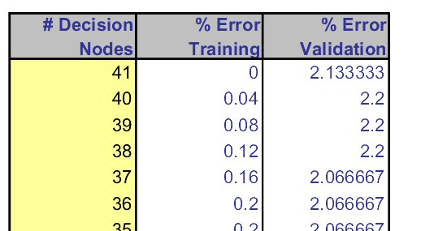
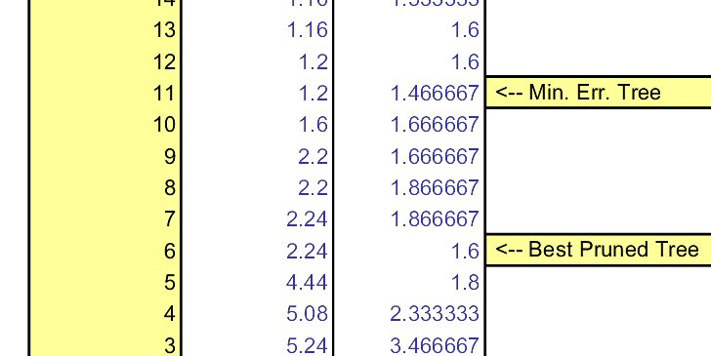
Error rates on pruned trees

Slide 31
Regression Trees

Slide 32
Regression Trees for Prediction
Used with continuous outcome variable
Procedure similar to classification tree
Many splits attempted, choose the one that minimizes impurity

Slide 33
Differences from CT
Prediction is computed as the average of numerical target variable in the rectangle (in CT it is majority vote)
Impurity measured by sum of squared deviations from leaf mean
Performance measured by RMSE (root mean squared error)

Slide 34
Advantages of trees
Easy to use, understand
Produce rules that are easy to interpret & implement
Variable selection & reduction is automatic
Do not require the assumptions of statistical models
Can work without extensive handling of missing data

Slide 35
Disadvantages
May not perform well where there is structure in the data that is not well captured by horizontal or vertical splits
Since the process deals with one variable at a time, no way to capture interactions between variables

Slide 36
Summary
Classification and Regression Trees are an easily understandable and transparent method for predicting or classifying new records
A tree is a graphical representation of a set of rules
Trees must be pruned to avoid over-fitting of the training data
As trees do not make any assumptions about the data structure, they usually require large samples

Slide 37
Cluster Analysis

Slide 38
What is Cluster Analysis?
Finding groups of objects such that the objects in a group will be similar (or related) to one another and different from (or unrelated to) the objects in other groups
Inter-cluster distances are maximized
Intra-cluster distances are minimized

Slide 39
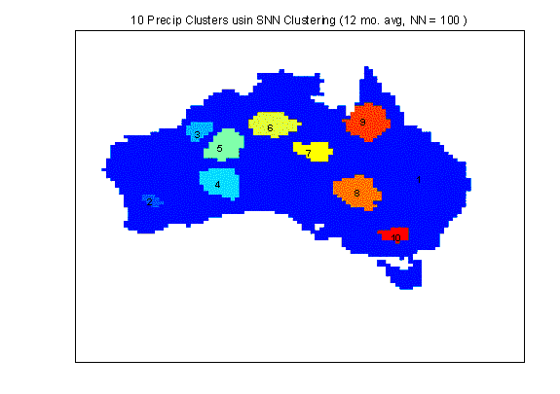
Applications of Cluster Analysis
Understanding
Group related documents for browsing, group genes and proteins that have similar functionality, or group stocks with similar price fluctuations
Summarization
Reduce the size of large data sets
Clustering precipitation in Australia

Slide 40
What is not Cluster Analysis?
Supervised classification
Have class label information
Simple segmentation
Dividing students into different registration groups alphabetically, by last name
Results of a query
Groupings are a result of an external specification
Graph partitioning
Some mutual relevance and synergy, but areas are not identical

Slide 41
Notion of a Cluster can be Ambiguous
How many clusters?
Six Clusters
Two Clusters
Four Clusters

Slide 42
Types of Clusterings
A clustering is a set of clusters
Important distinction between hierarchical and partitional sets of clusters
Partitional Clustering
A division data objects into non-overlapping subsets (clusters) such that each data object is in exactly one subset
Hierarchical clustering
A set of nested clusters organized as a hierarchical tree

Slide 43
Partitional Clustering
Original Points
A Partitional Clustering

Slide 44
Hierarchical Clustering
Traditional Hierarchical Clustering
Traditional Dendrogram
Non-traditional Hierarchical Clustering
Non-traditional Dendrogram

Slide 45
Other Distinctions Between Sets of Clusters
Exclusive versus non-exclusive
In non-exclusive clusterings, points may belong to multiple clusters.
Can represent multiple classes or ‘border’ points
Fuzzy versus non-fuzzy
In fuzzy clustering, a point belongs to every cluster with some weight between 0 and 1
Weights must sum to 1
Probabilistic clustering has similar characteristics
Partial versus complete
In some cases, we only want to cluster some of the data
Heterogeneous versus homogeneous
Cluster of widely different sizes, shapes, and densities

Slide 46
Types of Clusters
Well-separated clusters
Center-based clusters
Contiguous clusters
Density-based clusters
Property or Conceptual
Described by an Objective Function

Slide 47
Types of Clusters: Well-Separated
Well-Separated Clusters:
A cluster is a set of points such that any point in a cluster is closer (or more similar) to every other point in the cluster than to any point not in the cluster.
3 well-separated clusters

Slide 48
Types of Clusters: Center-Based
Center-based
A cluster is a set of objects such that an object in a cluster is closer (more similar) to the “center” of a cluster, than to the center of any other cluster
The center of a cluster is often a centroid, the average of all the points in the cluster, or a medoid, the most “representative” point of a cluster
4 center-based clusters

Slide 49
Types of Clusters: Contiguity-Based
Contiguous Cluster (Nearest neighbor or Transitive)
A cluster is a set of points such that a point in a cluster is closer (or more similar) to one or more other points in the cluster than to any point not in the cluster.
8 contiguous clusters

Slide 50
Types of Clusters: Density-Based
Density-based
A cluster is a dense region of points, which is separated by low-density regions, from other regions of high density.
Used when the clusters are irregular or intertwined, and when noise and outliers are present.
6 density-based clusters

Slide 51
Types of Clusters: Conceptual Clusters
Shared Property or Conceptual Clusters
Finds clusters that share some common property or represent a particular concept.
.
2 Overlapping Circles

Slide 52
Types of Clusters: Objective Function
Clusters Defined by an Objective Function
Finds clusters that minimize or maximize an objective function.
Enumerate all possible ways of dividing the points into clusters and evaluate the `goodness' of each potential set of clusters by using the given objective function. (NP Hard)
Can have global or local objectives.
Hierarchical clustering algorithms typically have local objectives
Partitional algorithms typically have global objectives
A variation of the global objective function approach is to fit the data to a parameterized model.
Parameters for the model are determined from the data.
Mixture models assume that the data is a ‘mixture' of a number of statistical distributions.

Slide 53
Types of Clusters: Objective Function …
Map the clustering problem to a different domain and solve a related problem in that domain
Proximity matrix defines a weighted graph, where the nodes are the points being clustered, and the weighted edges represent the proximities between points
Clustering is equivalent to breaking the graph into connected components, one for each cluster.
Want to minimize the edge weight between clusters and maximize the edge weight within clusters

Slide 54
Characteristics of the Input Data Are Important
Type of proximity or density measure
This is a derived measure, but central to clustering
Sparseness
Dictates type of similarity
Adds to efficiency
Attribute type
Dictates type of similarity
Type of Data
Dictates type of similarity
Other characteristics, e.g., autocorrelation
Dimensionality
Noise and Outliers
Type of Distribution

Slide 55
Clustering Algorithms
K-means and its variants
Hierarchical clustering
Density-based clustering

Slide 56
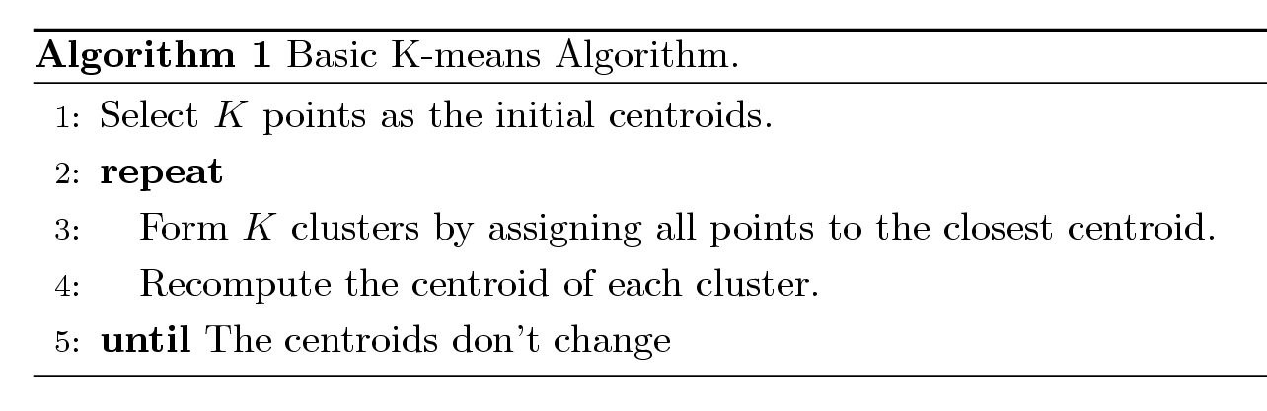
K-means Clustering
Partitional clustering approach
Each cluster is associated with a centroid (center point)
Each point is assigned to the cluster with the closest centroid
Number of clusters, K, must be specified
The basic algorithm is very simple

Slide 57
K-means Clustering – Details
Initial centroids are often chosen randomly.
Clusters produced vary from one run to another.
The centroid is (typically) the mean of the points in the cluster.
‘Closeness’ is measured by Euclidean distance, cosine similarity, correlation, etc.
K-means will converge for common similarity measures mentioned above.
Most of the convergence happens in the first few iterations.
Often the stopping condition is changed to ‘Until relatively few points change clusters’
Complexity is O( n * K * I * d )
n = number of points, K = number of clusters, I = number of iterations, d = number of attributes

Slide 58
Two different K-means Clusterings
Original Points
Optimal Clustering
Sub-optimal Clustering

Slide 59
Importance of Choosing Initial Centroids

Slide 60
Importance of Choosing Initial Centroids

Slide 61
Evaluating K-means Clusters
Most common measure is Sum of Squared Error (SSE)
For each point, the error is the distance to the nearest cluster
To get SSE, we square these errors and sum them.
x is a data point in cluster C_{i} and m_{i} is the representative point for cluster C_{i}
can show that m_{i} corresponds to the center (mean) of the cluster
Given two clusters, we can choose the one with the smallest error
One easy way to reduce SSE is to increase K, the number of clusters
A good clustering with smaller K can have a lower SSE than a poor clustering with higher K

Slide 62
Importance of Choosing Initial Centroids …

Slide 63
Importance of Choosing Initial Centroids …

Slide 64
Solutions to Initial Centroids Problem
Multiple runs
Helps, but probability is not on your side
Sample and use hierarchical clustering to determine initial centroids
Select more than k initial centroids and then select among these initial centroids
Select most widely separated
Postprocessing
Bisecting K-means
Not as susceptible to initialization issues

Slide 65
Handling Empty Clusters
Basic K-means algorithm can yield empty clusters
Several strategies
Choose the point that contributes most to SSE
Choose a point from the cluster with the highest SSE
If there are several empty clusters, the above can be repeated several times.

Slide 66
Updating Centers Incrementally
In the basic K-means algorithm, centroids are updated after all points are assigned to a centroid
An alternative is to update the centroids after each assignment (incremental approach)
Each assignment updates zero or two centroids
More expensive
Introduces an order dependency
Never get an empty cluster
Can use “weights” to change the impact

Slide 67
Pre-processing and Post-processing
Pre-processing
Normalize the data
Eliminate outliers
Post-processing
Eliminate small clusters that may represent outliers
Split ‘loose’ clusters, i.e., clusters with relatively high SSE
Merge clusters that are ‘close’ and that have relatively low SSE
Can use these steps during the clustering process
ISODATA

Slide 68
Limitations of K-means
K-means has problems when clusters are of differing
Sizes
Densities
Non-globular shapes
K-means has problems when the data contains outliers.

Slide 69
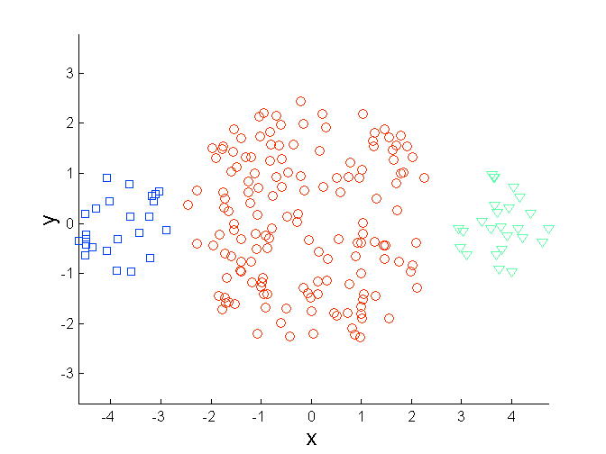
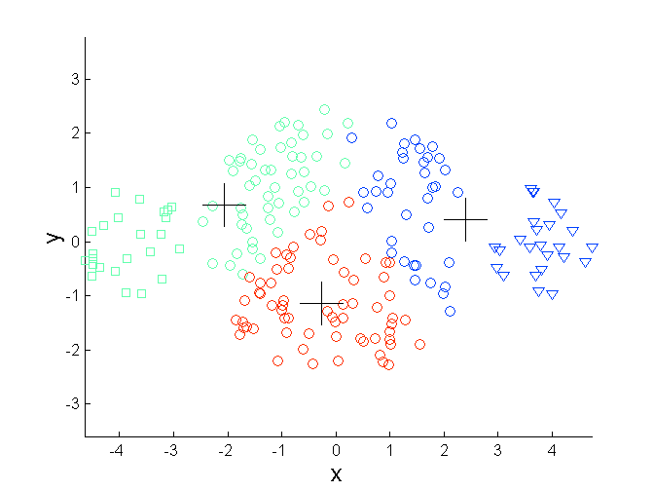
Limitations of K-means: Differing Sizes
Original Points
K-means (3 Clusters)

Slide 70
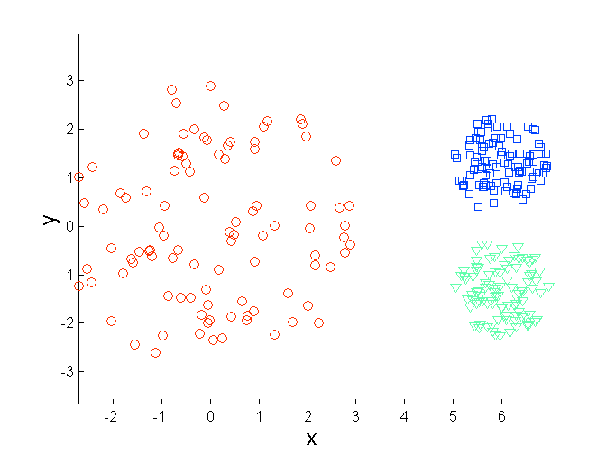
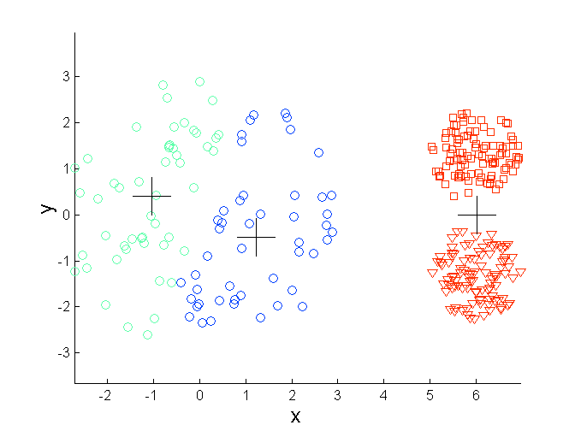
Limitations of K-means: Differing Density
Original Points
K-means (3 Clusters)

Slide 71
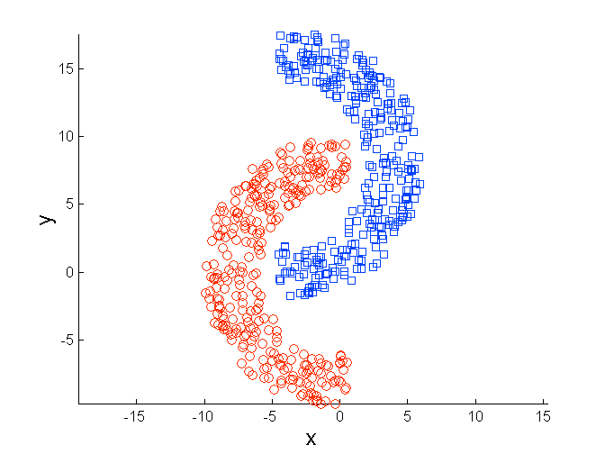
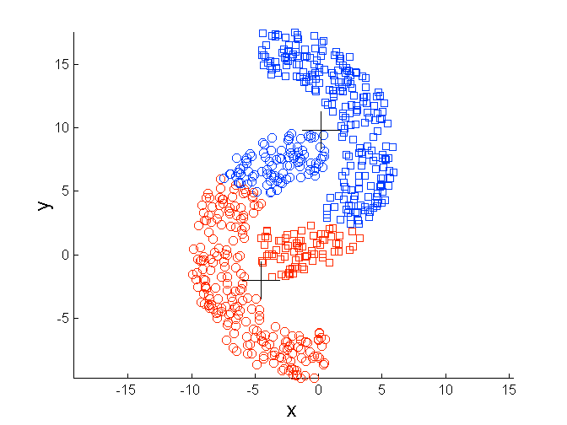
Limitations of K-means: Non-globular Shapes
Original Points
K-means (2 Clusters)

Slide 72
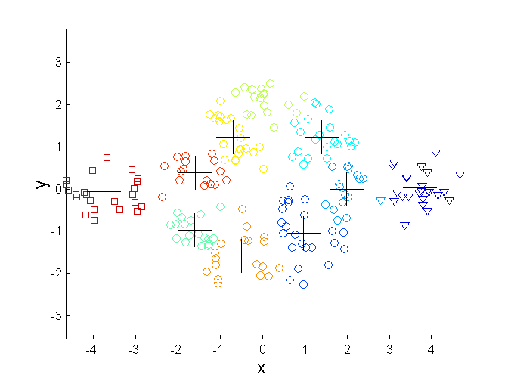
Overcoming K-means Limitations
Original Points K-means Clusters
One solution is to use many clusters.
Find parts of clusters, but need to put together.

Slide 73
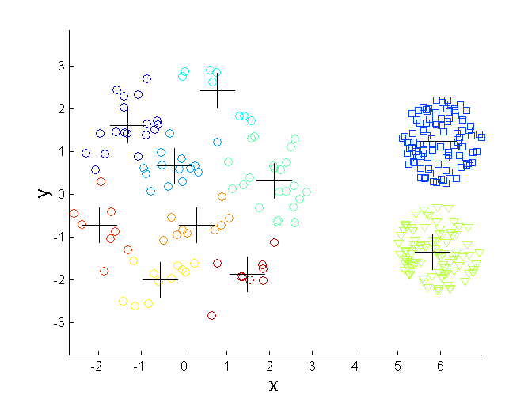
Overcoming K-means Limitations
Original Points K-means Clusters

Slide 74
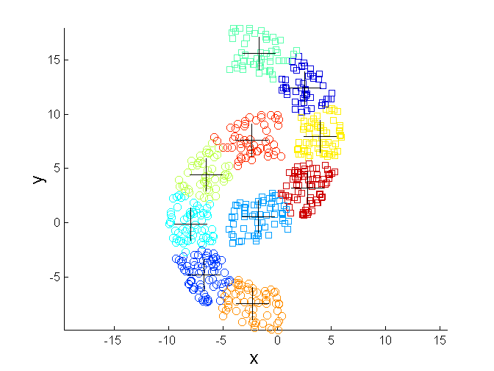
Overcoming K-means Limitations
Original Points K-means Clusters

Slide 75
Hierarchical Clustering
Produces a set of nested clusters organized as a hierarchical tree
Can be visualized as a dendrogram
A tree like diagram that records the sequences of merges or splits

Slide 76
Strengths of Hierarchical Clustering
Do not have to assume any particular number of clusters
Any desired number of clusters can be obtained by ‘cutting’ the dendogram at the proper level
They may correspond to meaningful taxonomies
Example in biological sciences (e.g., animal kingdom, phylogeny reconstruction, …)

Slide 77
Hierarchical Clustering
Two main types of hierarchical clustering
Agglomerative:
Start with the points as individual clusters
At each step, merge the closest pair of clusters until only one cluster (or k clusters) left
Divisive:
Start with one, all-inclusive cluster
At each step, split a cluster until each cluster contains a point (or there are k clusters)
Traditional hierarchical algorithms use a similarity or distance matrix
Merge or split one cluster at a time

Slide 78
How to Define Inter-Cluster Similarity
p1
p2
p3
p4
p5
. . .
p1
p2
p3
p4
p5
MIN
MAX
Group Average
Distance Between Centroids
Other methods driven by an objective function
Ward’s Method uses squared error
.
.
.
Proximity Matrix

Slide 79
How to Define Inter-Cluster Similarity
p1
p2
p3
p4
p5
. . .
p1
p2
p3
p4
p5
MIN
MAX
Group Average
Distance Between Centroids
Other methods driven by an objective function
Ward’s Method uses squared error
.
.
.
Proximity Matrix

Slide 80
How to Define Inter-Cluster Similarity
p1
p2
p3
p4
p5
. . .
p1
p2
p3
p4
p5
MIN
MAX
Group Average
Distance Between Centroids
Other methods driven by an objective function
Ward’s Method uses squared error
.
.
.
Proximity Matrix

Slide 81
How to Define Inter-Cluster Similarity
p1
p2
p3
p4
p5
. . .
p1
×
×
p2
p3
p4
p5
MIN
MAX
Group Average
Distance Between Centroids
Other methods driven by an objective function
Ward’s Method uses squared error
.
.
.
Proximity Matrix

Slide 82
Hierarchical Clustering: Comparison
5
1
4
1
3
2
5
5
5
2
1
MIN
2
MAX
2
3
6
3
3
6
1
4
4
4
5
5
1
4
1
2
2
5
2
Ward’s Method
5
2
3
6
Group Average
3
3
6
4
1
1
4
4
3

Slide 83
Hierarchical Clustering: Problems and Limitations
Once a decision is made to combine two clusters, it cannot be undone
No objective function is directly minimized
Different schemes have problems with one or more of the following:
Sensitivity to noise and outliers
Difficulty handling different sized clusters and convex shapes
Breaking large clusters

Slide 84
Different Aspects of Cluster Validation
Determining the clustering tendency of a set of data, i.e., distinguishing whether non-random structure actually exists in the data.
Comparing the results of a cluster analysis to externally known results, e.g., to externally given class labels.
Evaluating how well the results of a cluster analysis fit the data without reference to external information.
- Use only the data
Comparing the results of two different sets of cluster analyses to determine which is better.
Determining the ‘correct’ number of clusters.
For 2, 3, and 4, we can further distinguish whether we want to evaluate the entire clustering or just individual clusters.

Slide 85
Measures of Cluster Validity
Numerical measures that are applied to judge various aspects of cluster validity, are classified into the following three types.
External Index: Used to measure the extent to which cluster labels match externally supplied class labels.
Entropy
Internal Index: Used to measure the goodness of a clustering structure without respect to external information.
Sum of Squared Error (SSE)
Relative Index: Used to compare two different clusterings or clusters.
Often an external or internal index is used for this function, e.g., SSE or entropy
Sometimes these are referred to as criteria instead of indices
However, sometimes criterion is the general strategy and index is the numerical measure that implements the criterion.

Slide 86
Measuring Cluster Validity Via Correlation
Two matrices
Proximity Matrix
“Incidence” Matrix
One row and one column for each data point
An entry is 1 if the associated pair of points belong to the same cluster
An entry is 0 if the associated pair of points belongs to different clusters
Compute the correlation between the two matrices
Since the matrices are symmetric, only the correlation between n(n-1) / 2 entries needs to be calculated.
High correlation indicates that points that belong to the same cluster are close to each other.
Not a good measure for some density or contiguity based clusters.

Slide 87
Using Similarity Matrix for Cluster Validation
Order the similarity matrix with respect to cluster labels and inspect visually.

Slide 88
Using Similarity Matrix for Cluster Validation
Clusters in random data are not so crisp
K-means

Slide 89
Support Vector Machines

Slide 90
Linear Separators
Binary classification can be viewed as the task of separating classes in feature space:
w^{T}x + b = 0
w^{T}x + b > 0
w^{T}x + b < 0
f(x) = sign(w^{T}x + b)

Slide 91
Linear Separators
Which of the linear separators is optimal?

Slide 92
Classification Margin
Distance from example x_{i} to the separator is
Examples closest to the hyperplane are support vectors.
Margin ρ of the separator is the distance between support vectors.
ρ
r

Slide 93
Maximum Margin Classification
Maximizing the margin is good according to intuition and PAC theory.
Implies that only support vectors matter; other training examples are ignorable.

Slide 94
Linear SVM Mathematically
Let training set {(x_{i}, y_{i})}_{i=1..n}, x_{i}∈R^{d}, y_{i} ∈ {-1, 1} be separated by a hyperplane with margin ρ. Then for each training example (x_{i}, y_{i}):
For every support vector x_{s} the above inequality is an equality. After rescaling w and b by ρ/2 in the equality, we obtain that distance between each x_{s} and the hyperplane is
Then the margin can be expressed through (rescaled) w and b as:
w^{T}x_{i} + b ≤ - ρ/2 if y_{i} = -1
w^{T}x_{i} + b ≥ ρ/2 if y_{i} = 1
⇔
y_{i}(w^{T}x_{i} + b) ≥ ρ/2

Slide 95
Linear SVMs Mathematically (cont.)
Then we can formulate the quadratic optimization problem:
Which can be reformulated as:
Find w and b such that
is maximized
and for all (x_{i}, y_{i}), i=1..n : y_{i}(w^{T}x_{i} + b) ≥ 1
Find w and b such that
Φ(w) = ||w||²=w^{T}w is minimized
and for all (x_{i}, y_{i}), i=1..n : y_{i} (w^{T}x_{i} + b) ≥ 1

